Slide 1
Simple word games
by Kimberly Vega

Slide 2
The idea
When faced with reality...
I wanted to create word game that taught Spanish. I wanted it to be Hangman.
I rethought Hangman. Wasn’t much documentation. Had no idea how to start.
I’d make a simpler game where the letters fade in and out on stage, move around, you had to “catch” them or something.
I would create a word game that not only taught Spanish, it could be used to teach other things.

Slide 3
Other things my game might teach
JAVASCRIPT terms!!
And so began my journey….

Slide 4
Challenges
I could hide Letter Sprites but could not find ready documentation on how to fade.
It took a while to figure out how to find the sounds.
Letter Sprites would actually go off stage & that made them hard to see.
Letter Sprites did not stop when clicked.
Letter Sprites kept going behind the “Clue” Sprite.
If you clicked on Letter Sprites at the incorrect time, they would disappear for good.

Slide 5
More challenges
I created a sorta functional game WITHOUT using a variable.
And mayyyyyybee I had a conditional.
Although I did create two blocks or functions.
And yes, used a loop.
But it wasn’t what the assignment asked for.

Slide 6
More challenges
I asked for help & Pow said to create a Score variable.
I then figured out how to get a Scoreboard to show in the upper left when you clicked on Letter Sprites.
But even after a Letter Sprite had been “caught” you could still get as many points as you wanted by clicking on it.

Slide 7
And then...

Slide 8
I broke the game.
I had to copy pieces of scripts into my backpack & redo the whole thing.

Slide 9
Solutions
The problem?
I could hide letters but could not find ready documentation on how to fade.
Solution? I took a different path, i.e. changed the way the game would look when played.
The problem?
It took awhile to figure out how to find the sounds.
Solution? I just clicked around until I found it.

Slide 10
Solutions
The problem?
The letters would partially go off stage, making them hard to see.
Solution? I set x & y coordinates for the Letter Sprites to keep them on stage.

Slide 11
Solutions
The problem?
The letters did not stop when clicked.
Solution? I used a “repeat until” loop with a sensing block.
The problem?
I didn’t have a conditional loop.
Solution? I got my conditional into the project using a “Repeat Until” to get a Sensing block to stop motion once a Letter Sprite was touched.

Slide 12
Name game
Version 1 -- What is the Spanish name for cake?
Version 2 -- What is the Spanish name for strawberry?

Slide 13
Nope.
The letters still go behind the “clue” Sprite.
If you click at the wrong time, the Letter Sprites will still sometimes disappear.
They won’t reappear until the game is reset.
You can still click on a Letter Sprite as many times as you want & increase your score.
Ah well….

Slide 14
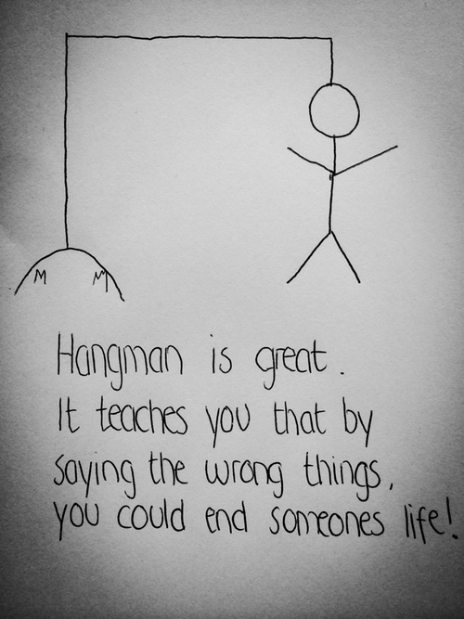
Part II

Slide 15
Part II
I still wanted to create a simple Hangman game.
Not so simple.

Slide 16
Challenge 1
There wasn’t a lot of good documentation.

Slide 17
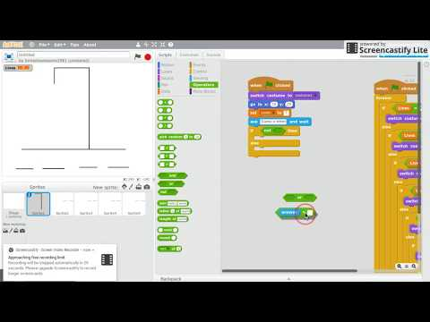
Solution?
Youtube!!!
I followed the video & copied.
I ended up learning a lot. Some things I learned….
How simple operators work.
How to create my own Sprites & text.
I created my own background options & realized I could upload my own images.

Slide 18
Challenges
The Youtube did not explain how to finish the project.
I worked on it trying to solve the infinite loop I’d found myself in.
And then….

Slide 19
I broke the game.
I decided to go to Pow for help.
She found the error.
Showed me how to code the solution.

Slide 20
Hangman works...
A new Letters variable was created that counted DOWN every time the guess was correct.
A Stop Script block was added to the end of the series of if-loops.
Something similar was employed to the Lives script.

Slide 21
Part III

Slide 22
More word games
I wanted to see if I could improve on my incredibly basic game.
So I did this….
And this….

Slide 23
More word games
Since I like having educational goals, when I finished Name Games 1 & 2, I’d thought to use these games to learn JAVASCRIPT syntax.

Slide 24
I used what I’d learned from building Hangman & created a SLIGHTLY more sophisticated game to quiz JS syntax.
Who wants to come up here and try it?

